Slide 1

Sustainability Through Water Meter Insights
Nicholas Seah, Ashkan Taghavi, Mehrpad Moattari, Jake Aaknes, Ryan Perez

Slide 2
A Brief History
Spread of CA Drought:
Dec 2013 to July 2014
2014: California's worst drought to date in 1,200 years
No widely used methods for tracking water use
Flume Water was born to address this gap, and provide high-definition water data via the Flume Water Meter

Slide 3
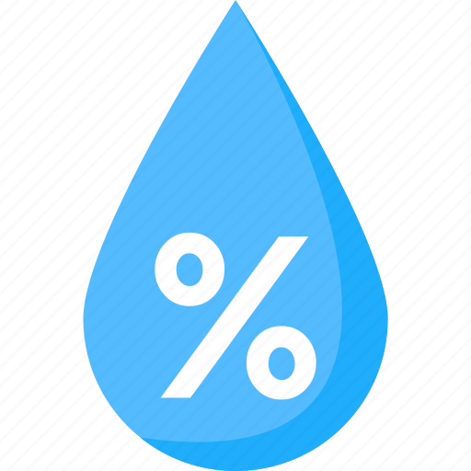

What is Flume Water Company?
Flume Water Company
Innovative technology company focused on smart water management solutions
Aims to promote water conservation and manage water use more efficiently
Offers real-time water usage monitoring and leak detection through app & API
Benefits of Using Flume
Environmental impact: Supports water conservation efforts and reduces unnecessary water usage
User-friendly: Intuitive app provides detailed usage reports, historical data, and customizable alerts

Slide 4
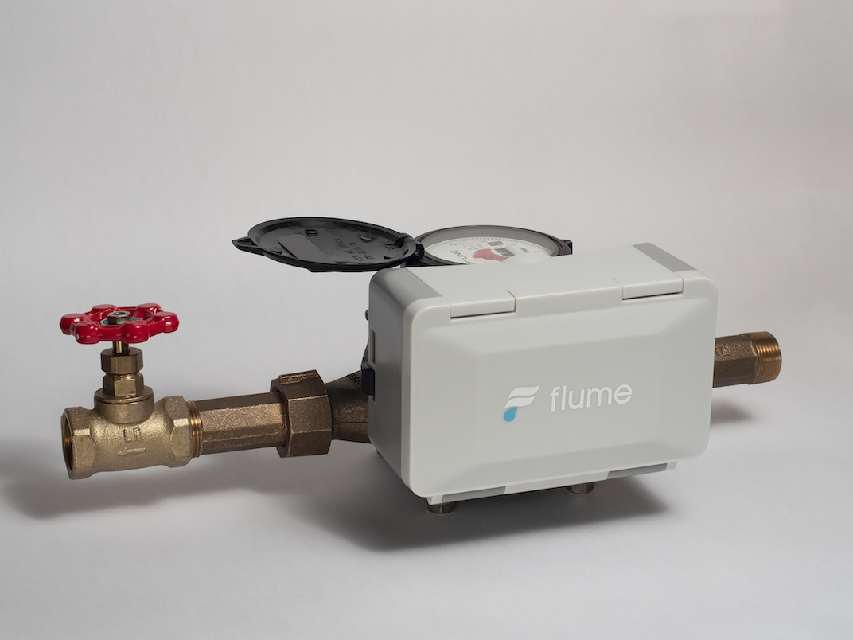
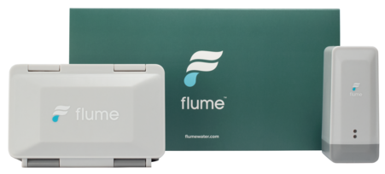
What is the Flume Device?
Device Features
Simple Installation:
Directly attaches to any home water meter; no plumbing required, DIY setup
Real-time Monitoring:
Utilizes wireless technology to track water usage patterns and send data to an app, allowing users to monitor consumption at anytime
Data-Driven Insights:
Analyzes usage to provide recommendations for water consumption, cost savings, and environmental conservation

Slide 5
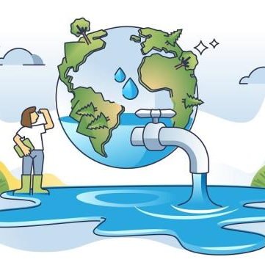
Project objective
Leverage Flume personal water meter data via API access.
Optimize water consumption through actionable insights.
Empower these insights through a self-updating cloud analysis.

Slide 6
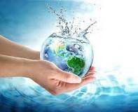
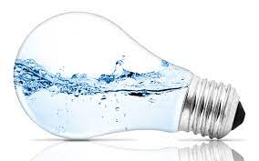
Why Flume?
Local and Niche Focus:
By exploring water consumption at the individual level, the project addresses a niche aspect of sustainability directly relevant to daily life, distinguishing it from broader water conservation initiatives.
Impactful Innovation:
Offering practical recommendations derived from personal water usage data, the project provides a novel solution that directly impacts users' conservation behaviors in their immediate environments.

Slide 7

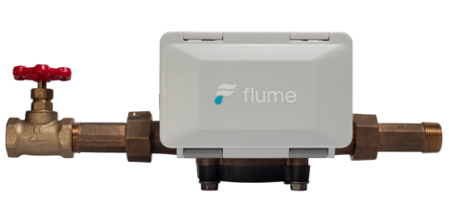



Ingestion and Processing
Personal Water Meter

Slide 8
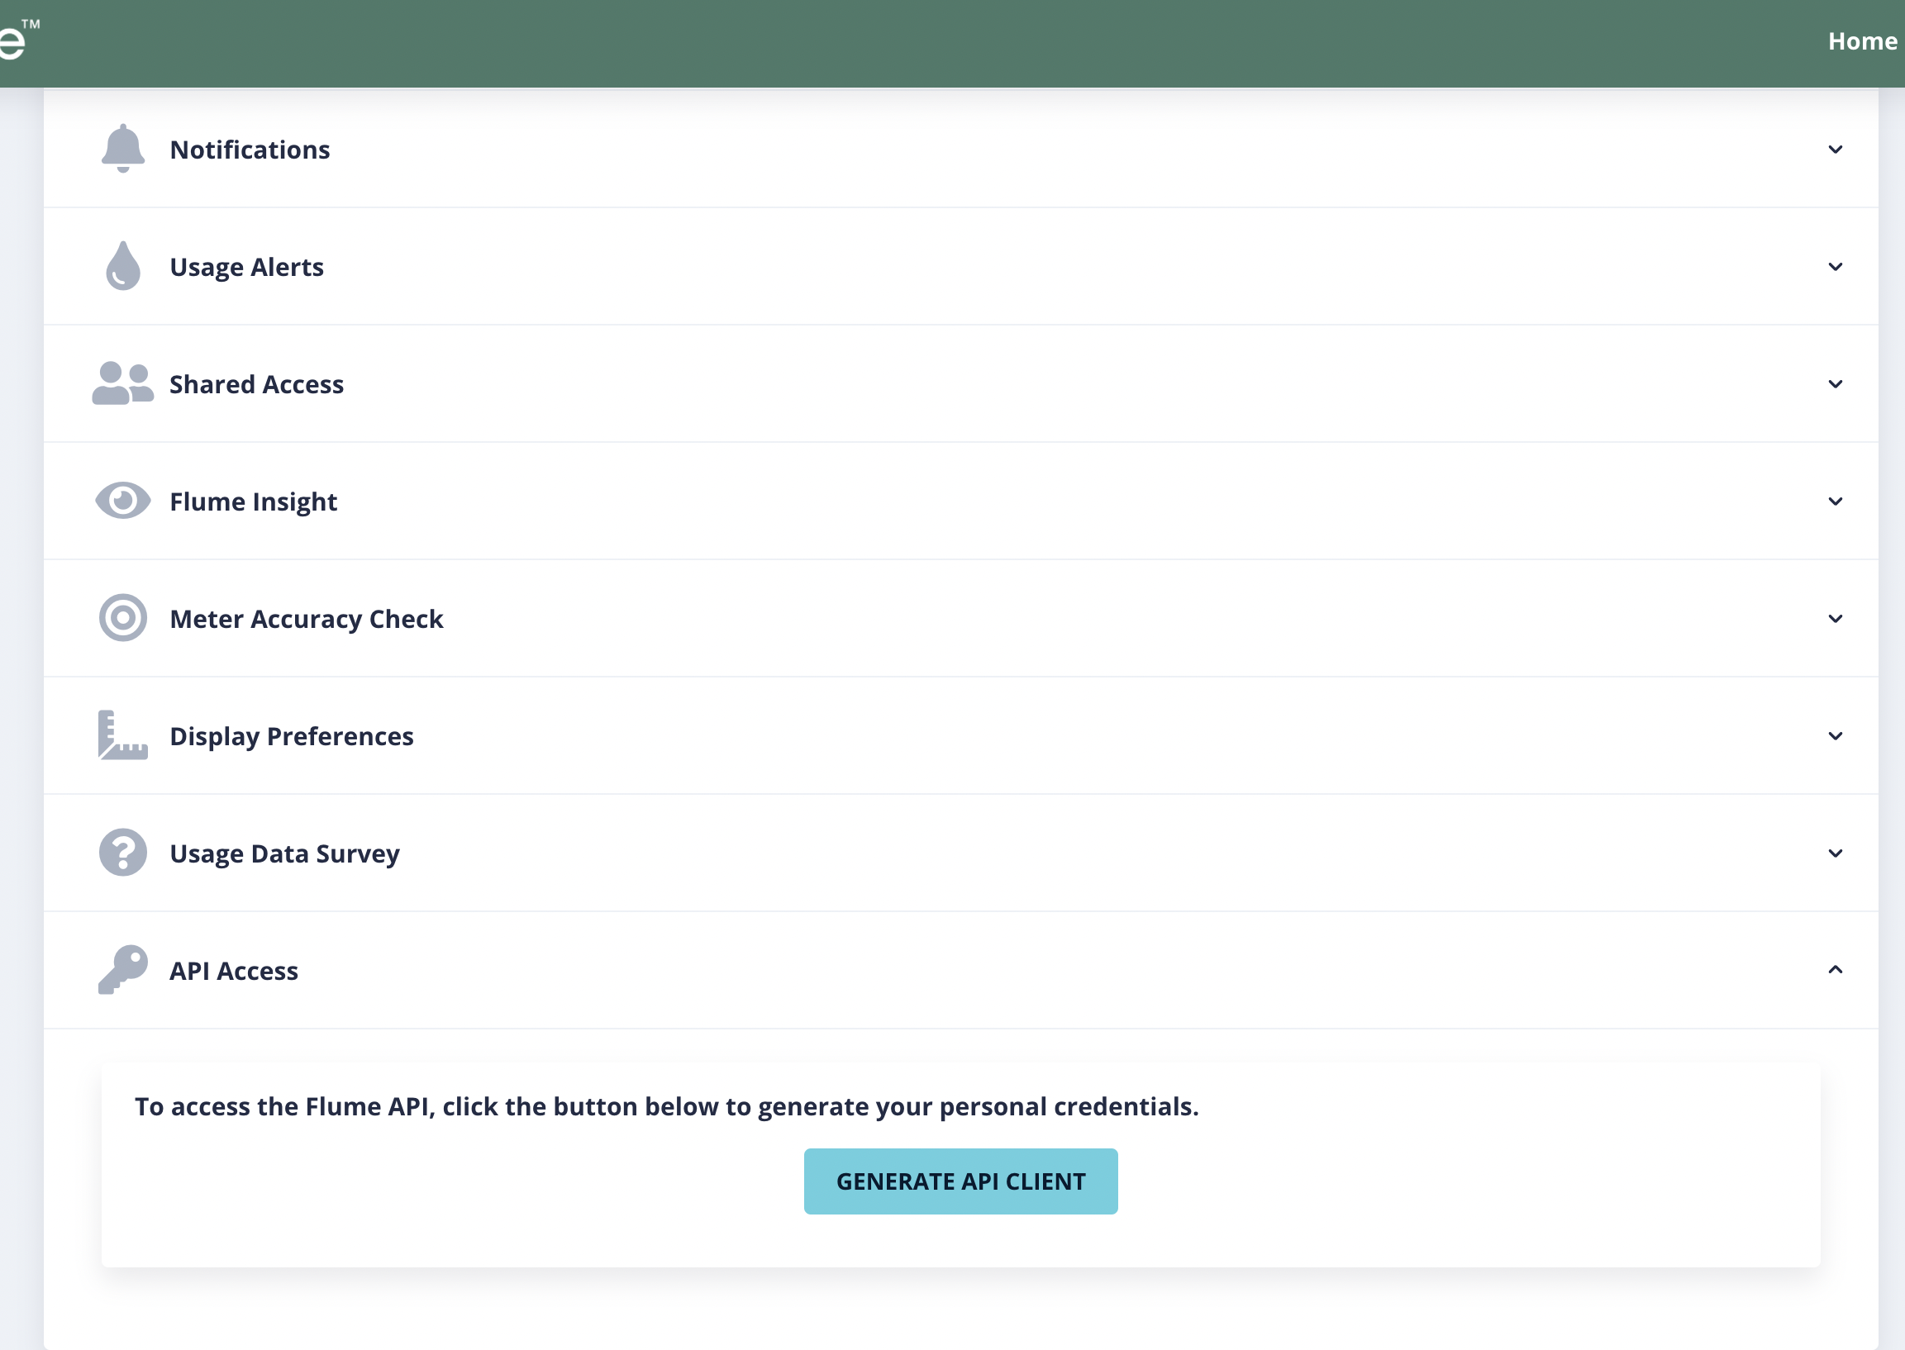
API Access
Access through account username and password
Generate API credentials through User Dashboard
Notes:
Authenticating with the API: customers will receive access token to use the API and will pass it through the bearer authorization header.
Getting tokens: JSON Web Token required, after that flume provides information only to the customer to keep access limited.

Slide 9
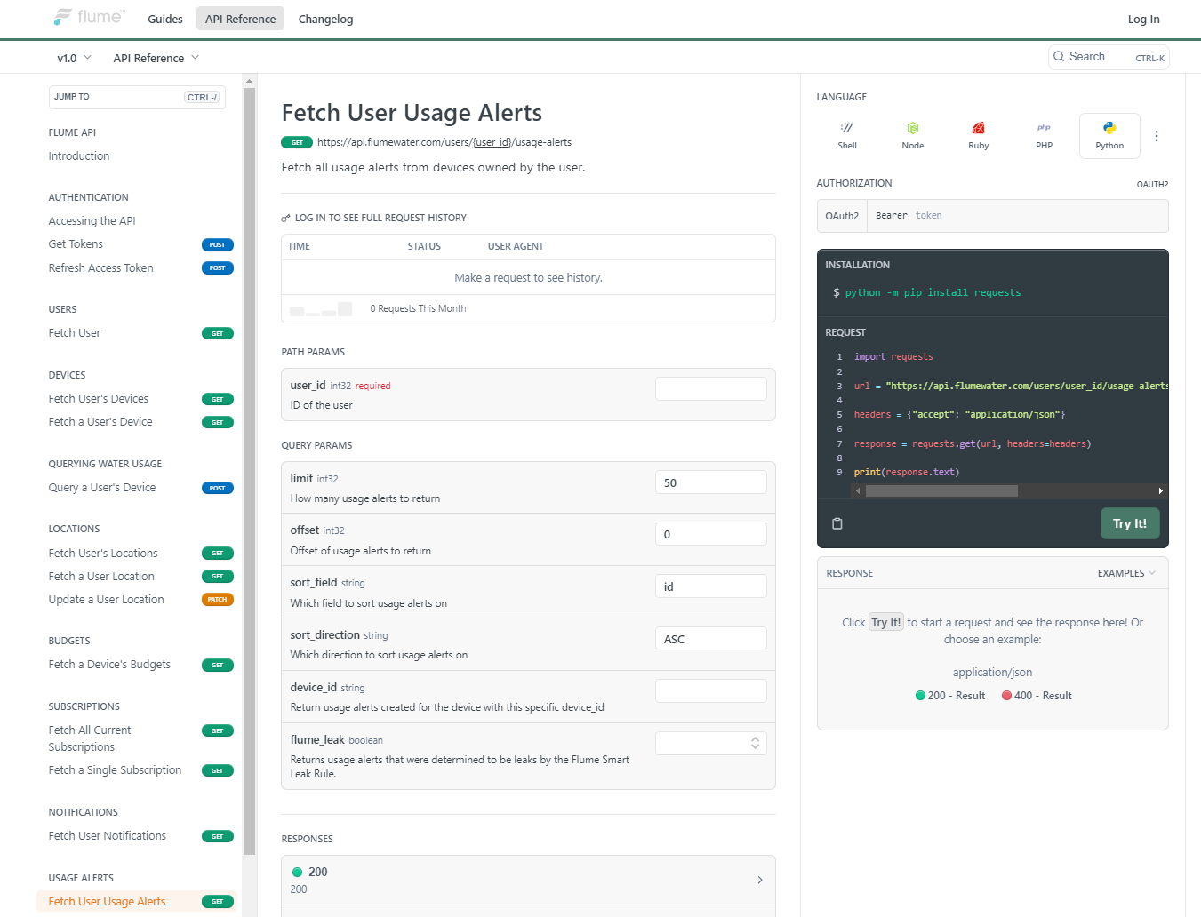

Slide 10
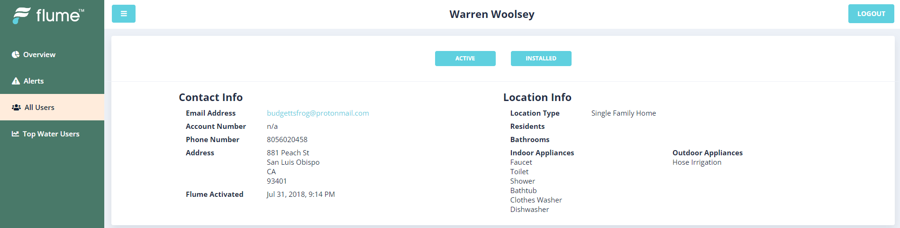
Demo Account:
By Reaching out the Flume team, we were able to gain access to data from a demo account.
The sample data is water usage of a family of four from 1-21 to 2-22.

Slide 11
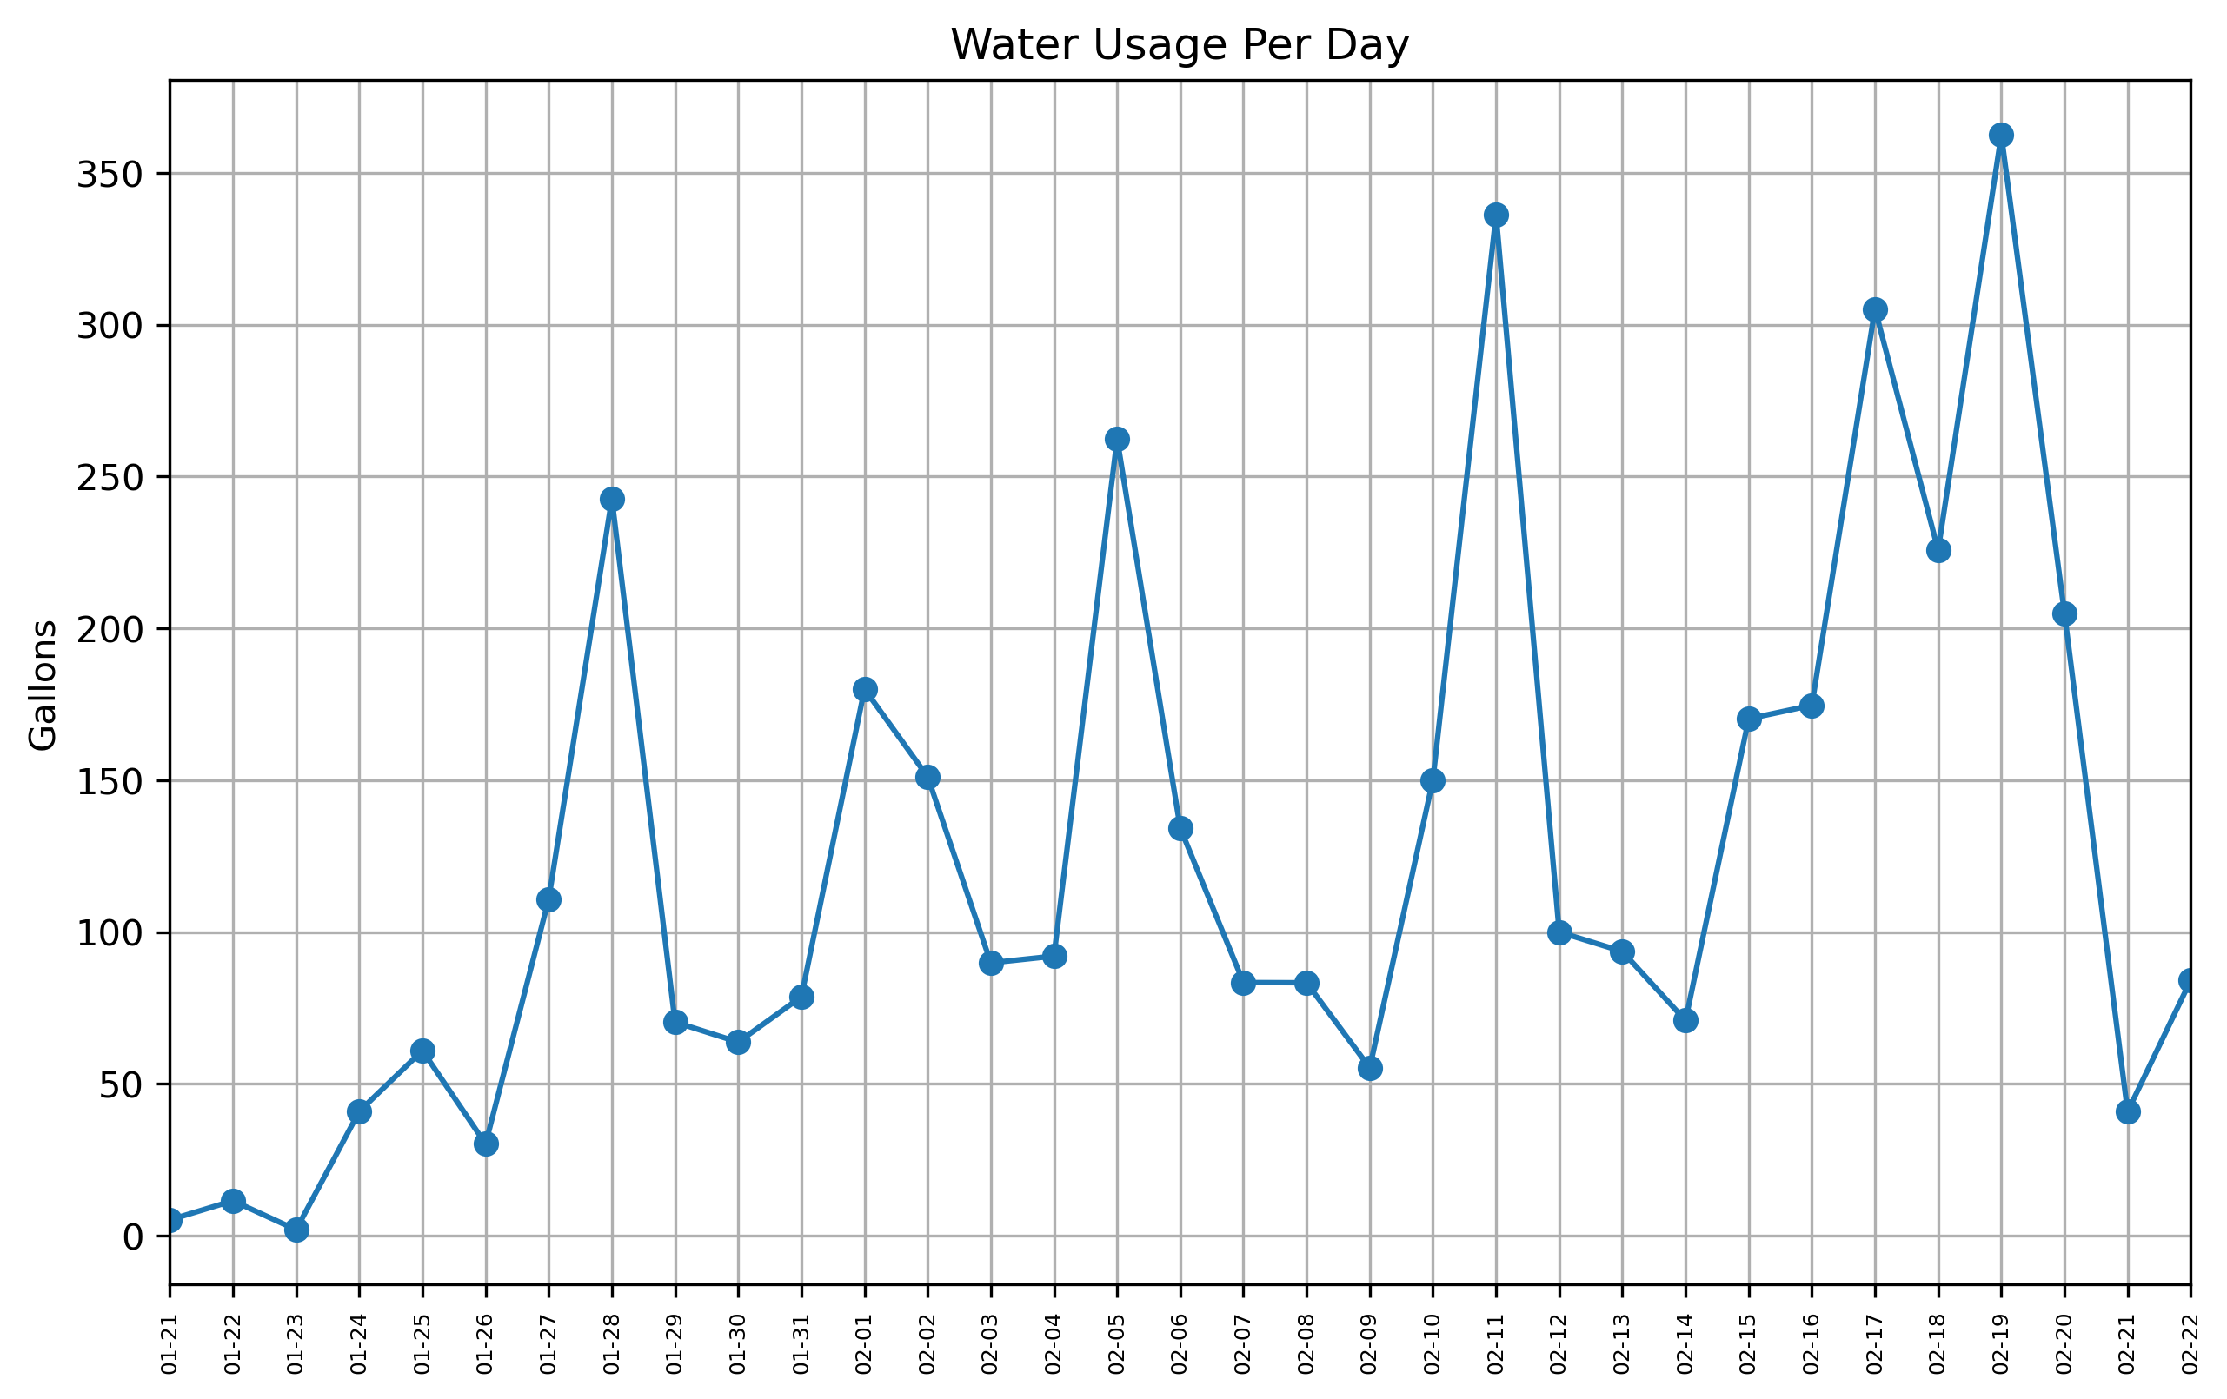
Super Bowl Party?

Slide 12
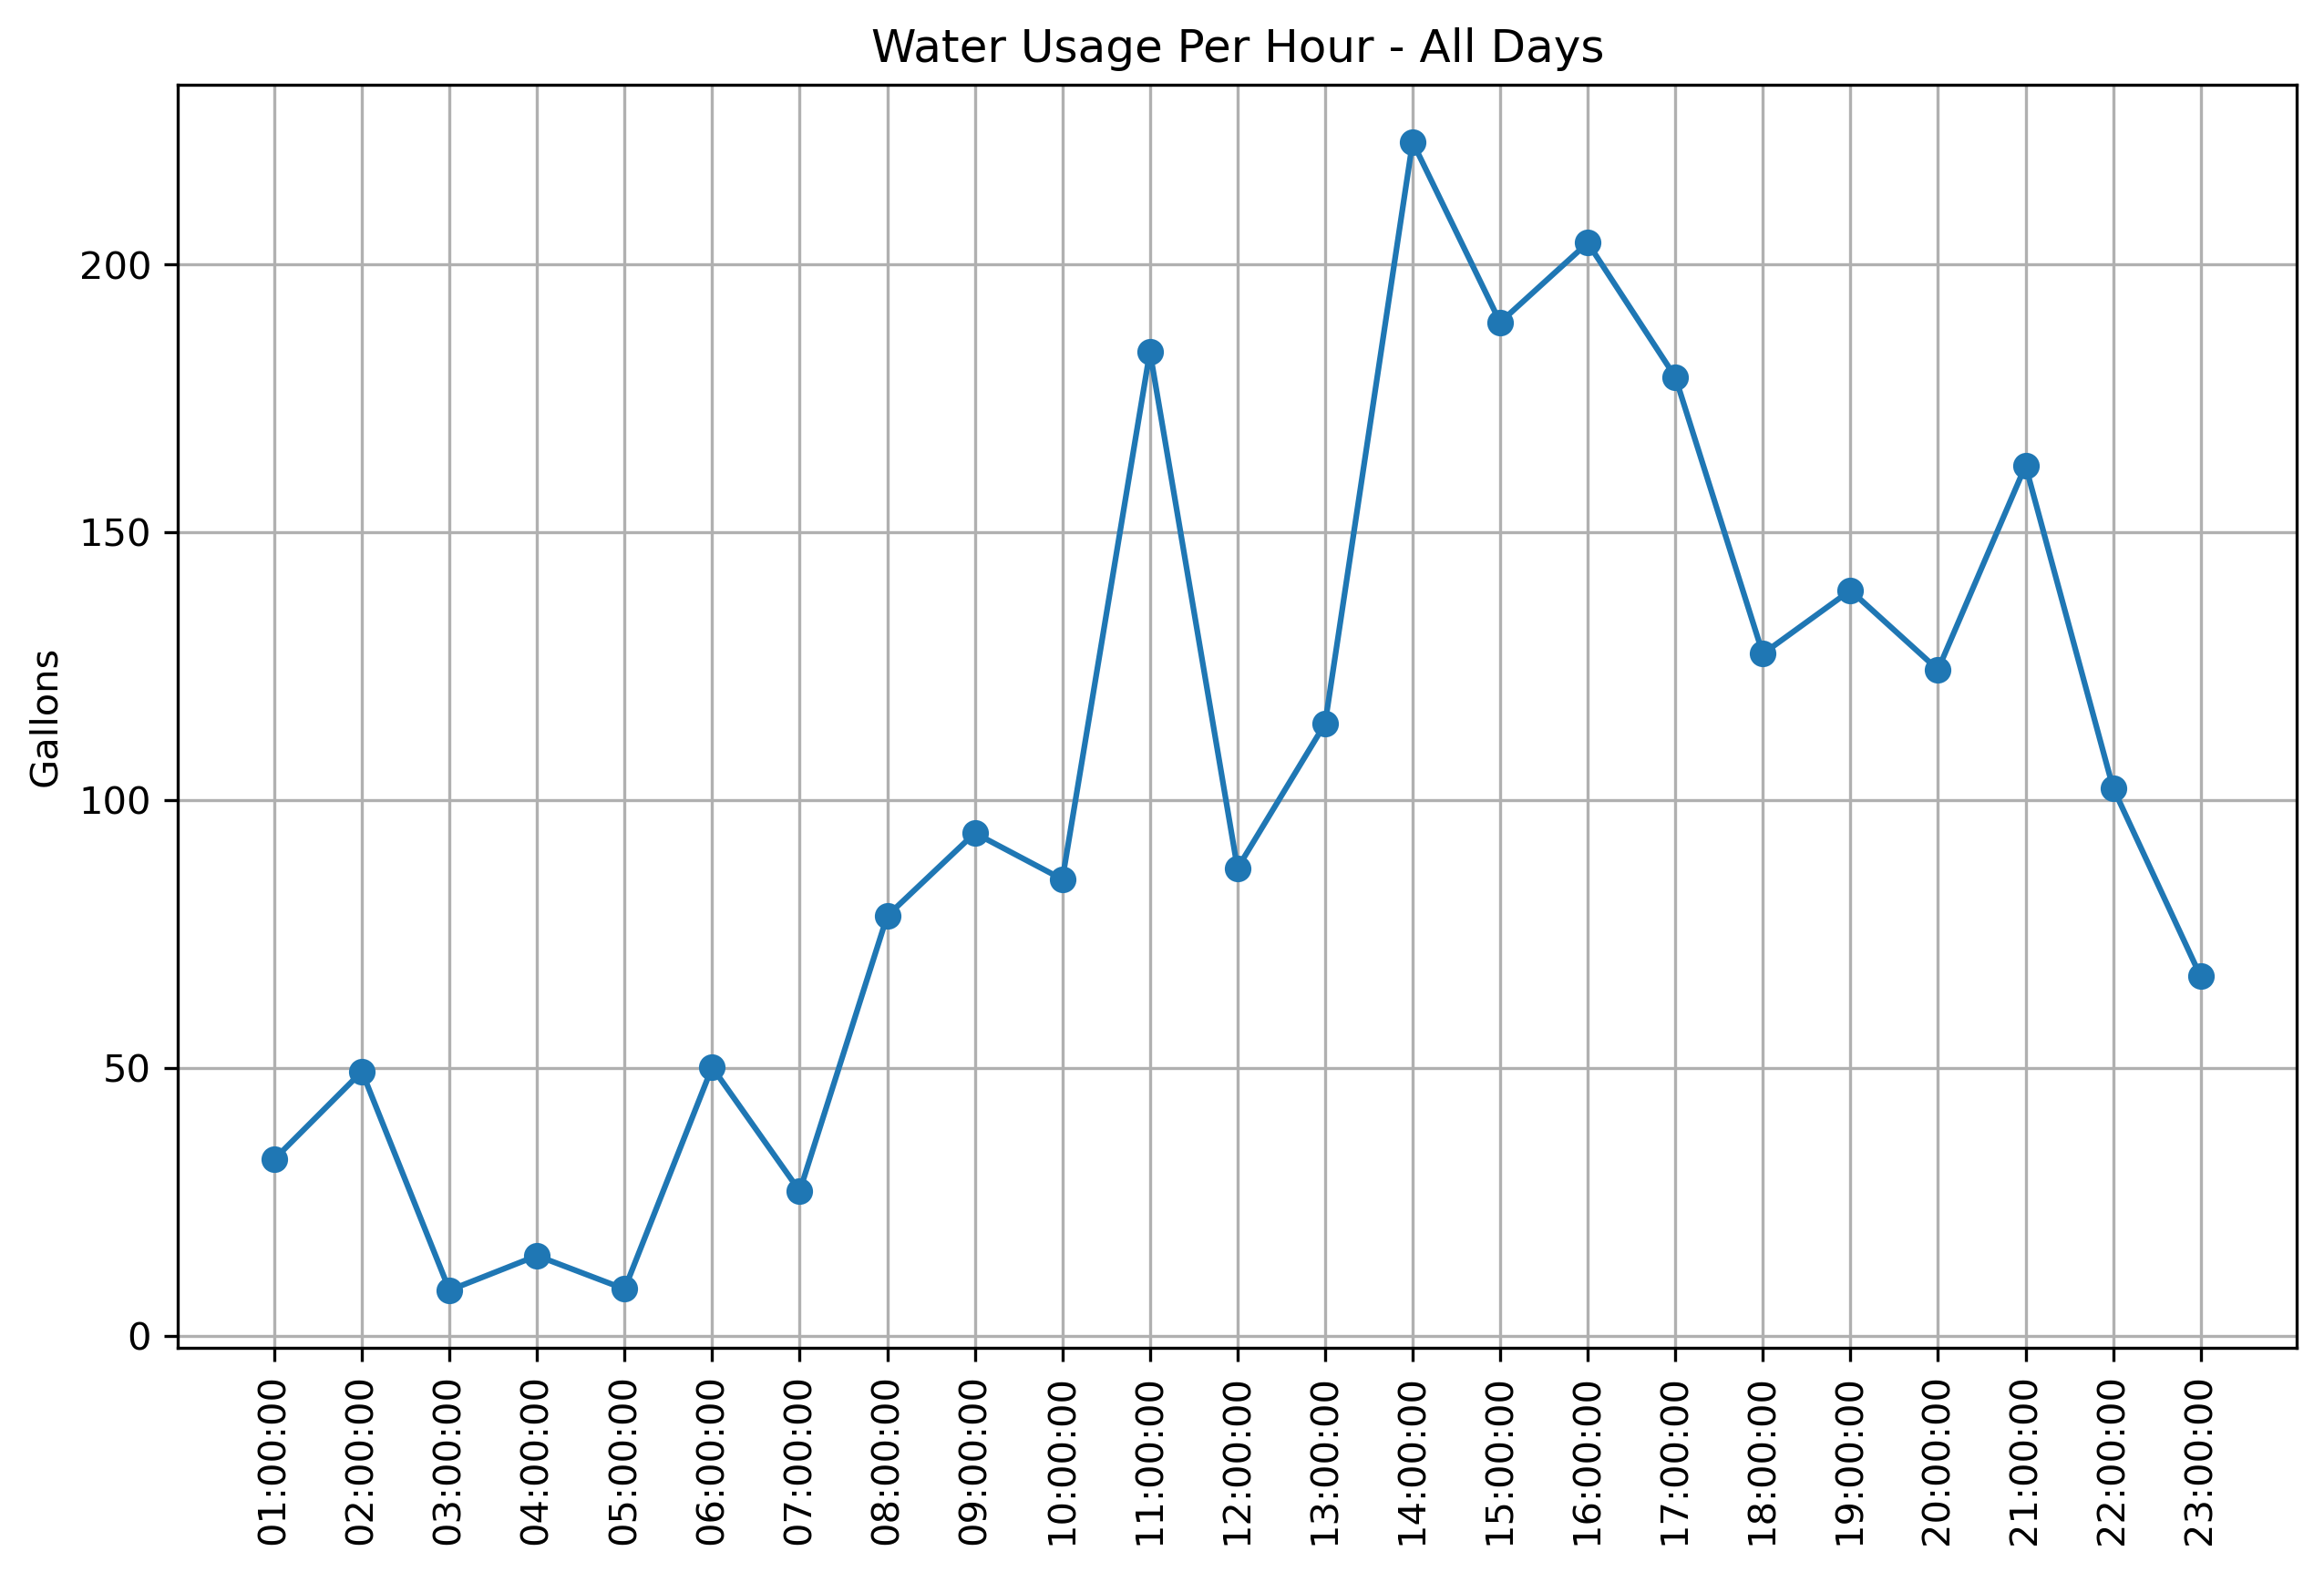
Shower Before Bed?

Slide 13
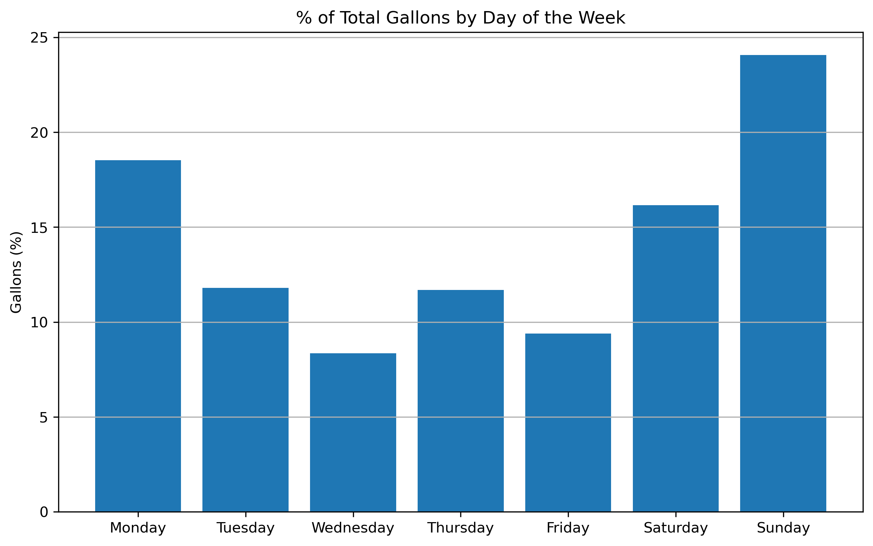
Laundry on Sundays Only?

Slide 14
Analysis Ideas
Daily Water Usage Trends
Pinpoint Peak Times
Identify Daily Patterns
Appliance Usage Impacts
Identify devices contributing the most to usage
Investigate proportion of total usage for each appliance
Consider indoor vs outdoor
Identify Anomalies
Find reason for Spikes and Drops in water usage
Discover potential leaks/water wastage areas
Customize alerts and leak detections
Graph Daily Cumulative Usage
Compare to California household daily water usage average

Slide 15
Next Steps
Automate our process
Consider creating AWS CDK
AWS Glue
Further Investigate our Research Goals
Create Visualizations to be Created at Daily Level
Consider Joining Outside data sources to find factors that go into increased water usage
Automate the Process
Further Investigation of the Research Goals
Create Visualizations
Consider Other Data Sources
AWS CDK
AWS Glue
Identify areas for water conservation
Provide users feedback on their daily water usage
Water Price Data
& Precipitation

Slide 16
Thank You
Feel free to ask us any questions!

Slide 17
iam policies for cdk, two s3 buckets to store daata and another with glue scripts, attach iam role to buckets so glue could access, deploy python scripts to scripts bucket, intitialize glue workflow with a job and a trigger, run it daily, fetch api key, glue job hits upi, create pandas data frame

Slide 18
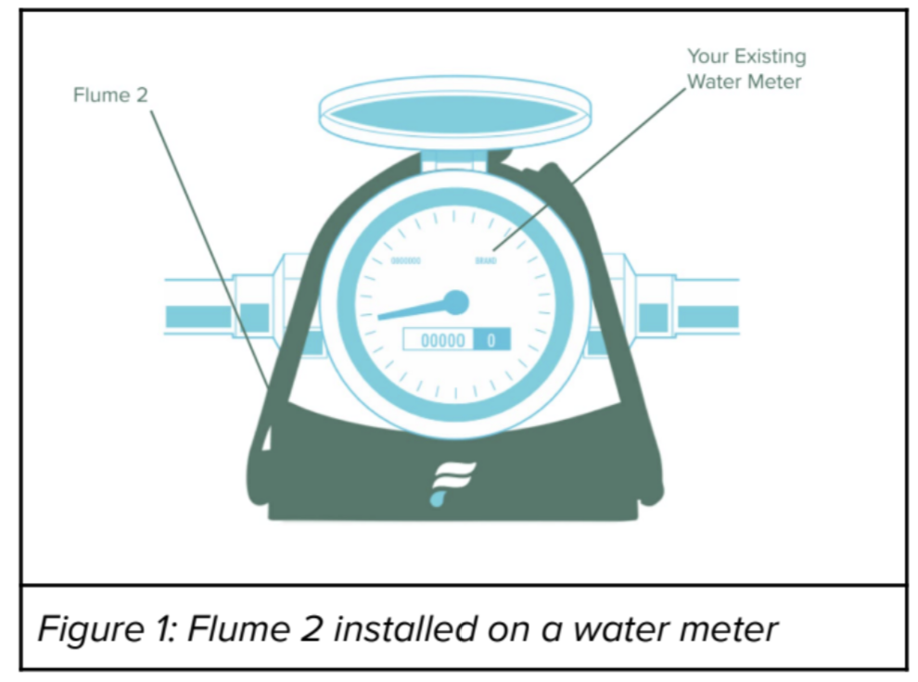

Slide 19
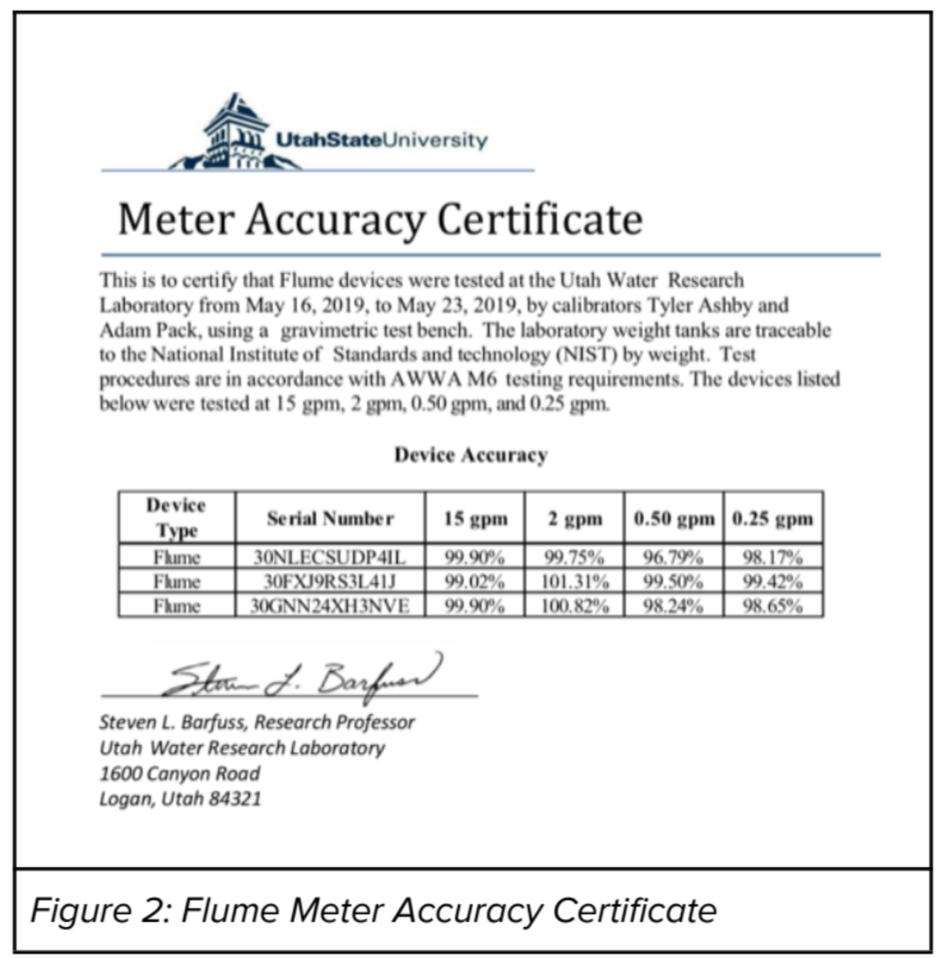

Slide 20
